Slide 1

Introduction to php

Slide 2
Php. overview
PHP is the language that you use to make the server generate dynamic output — output that is potentially different each time a browser requests a page.
I’ll also show you how to embed the PHP in an HTML file so that you can see what the output looks like in a web page.
In production, your web pages will be a combination of PHP, HTML, and JavaScript, and some MySQL statements laid out using CSS, and possibly utilizing various HTML5 elements.
Focus for now on just writing PHP code and making sure that you get the output you expect

Slide 3
Incorporating PHP Within HTML
By default, PHP documents end with the extension .php.
When a web server encounters this extension in a requested file, it automatically passes it to the PHP processor.
Your PHP program is responsible for passing back a clean file suitable for display in a web browser.
At its very simplest, a PHP document will output only HTML.
To prove this, you can take any normal HTML document such as an index.html file and save it as index.php, and it will display identically to the original.

Slide 4
Php commands
To trigger the PHP commands, you need to learn a new tag.
Here is the first part:
<? php
The first thing you may notice is that the tag has not been closed. This is because entire sections of PHP can be placed inside this tag, and they finish only when the closing part is encountered, which looks like this:
?>

Slide 5
PHP syntax
By the way, there is a slight variation to this. If you browse the Internet for PHP examples, you may also encounter code where the opening and closing syntax looks like this:
<? php
echo "Hello world";
?>

Slide 6
The $ symbol
In PHP, however, you must place a $ in front of all variables.
This is required to make the PHP parser faster, as it instantly knows whenever it comes across a variable. Whether your variables are numbers, strings, or arrays.
Example:
<? php
$ mycounter = 1;
$ mystring = "Hello";
$ myarray = array("One", "Two", "Three");
?>

Slide 7
Basic Syntax
PHP is quite a simple language with roots in C and Perl, yet it looks more like Java. It is also very flexible, but there are a few rules that you need to learn about its syntax and structure.
Semicolons
You may have noticed in the previous examples that the PHP commands ended with a semicolon, like this:
$ x + = 10;
Probably the most common cause of errors you will encounter with PHP is forgetting this semicolon.
This causes PHP to treat multiple statements like one statement, which it is unable to understand, prompting it to produce a Parse error message.

Slide 8
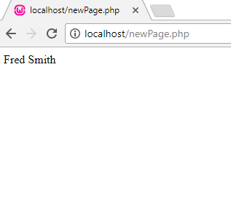
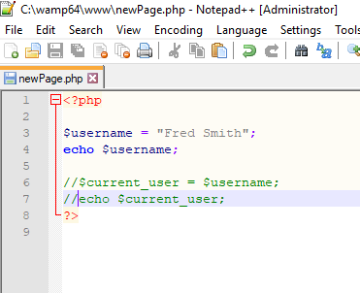
When you want to see what is in the box:
echo $ username;
Or you can assign it to another variable like this:
$ current_user = $ username;
First php program:

Slide 9
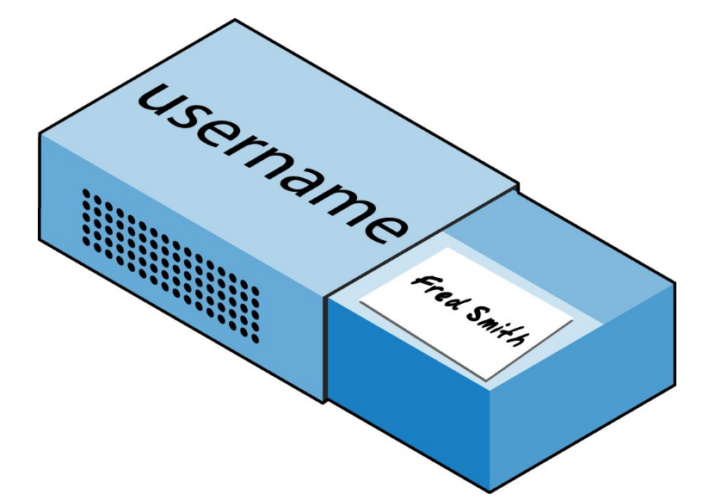
Variable
There’s a simple metaphor that will help you understand what PHP variables are all about.
Just think of them as little (or big) matchboxes! That’s right — matchboxes that you’ve painted over and written names on.
String variables
Imagine you have a matchbox on which you have written the word username.
You then write Fred Smith on a piece of paper and place it into the box
$ username = "Fred Smith";
The quotation marks indicate that “Fred Smith”
is a string of characters.
You must enclose each string in either quotation marks or apostrophes (single quotes), although there is a subtle difference between the two types of quote, which is explained later.

Slide 10
Numeric variables:
Variables don’t contain just strings — they can contain numbers too.
If we return to the matchbox analogy, to store the number 17 in the variable $ count, the equivalent would be placing, say, 17 beads in a matchbox on which you have written the word count:
$count = 17;
You could also use a floating-point number (containing a decimal point); the syntax is the same:
$count = 17.5;
To read the contents of the matchbox, you would simply open it and count the beads. In PHP, you would assign the value of $ count to another variable or perhaps just echo it to the web browser.

Slide 11

Arrays
So what are arrays? Well, you can think of them as several matchboxes glued together. For example, let’s say we want to store the player names for a five-person soccer team in an array called $ team.
To do this, we could glue five matchboxes side by side and write down the names of all the players on separate pieces of paper, placing one in each matchbox.
$ team = array(' Bill', 'Mary', 'Mike', 'Chris', 'Anne');
The array-building code consists of the following construct: array(); with five strings inside.
Each string is enclosed in apostrophes. If we then wanted to know who player 4 is, we could use this command:
echo $ team[ 3]; // Displays the name Chris
Nixon, Robin (2014-12-02). Learning PHP, MySQL & JavaScript: With jQuery, CSS & HTML5 (Learning Php, Mysql, Javascript, Css & Html5) O'Reilly Media.

Slide 12
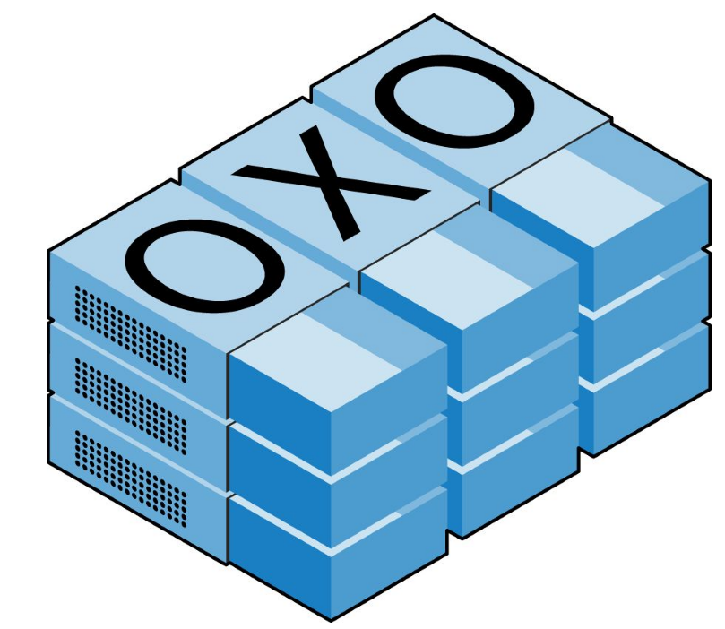
Two-dimensional arrays
They can be two-dimensional matrixes or can even have three or more dimensions.
As an example of a two-dimensional array, let’s say we want to keep track of a game of tic-tac-toe, which requires a data structure of nine cells arranged in a 3 × 3 square. To represent this with matchboxes, imagine nine of them glued to each other in a matrix of three rows by three columns

Slide 13
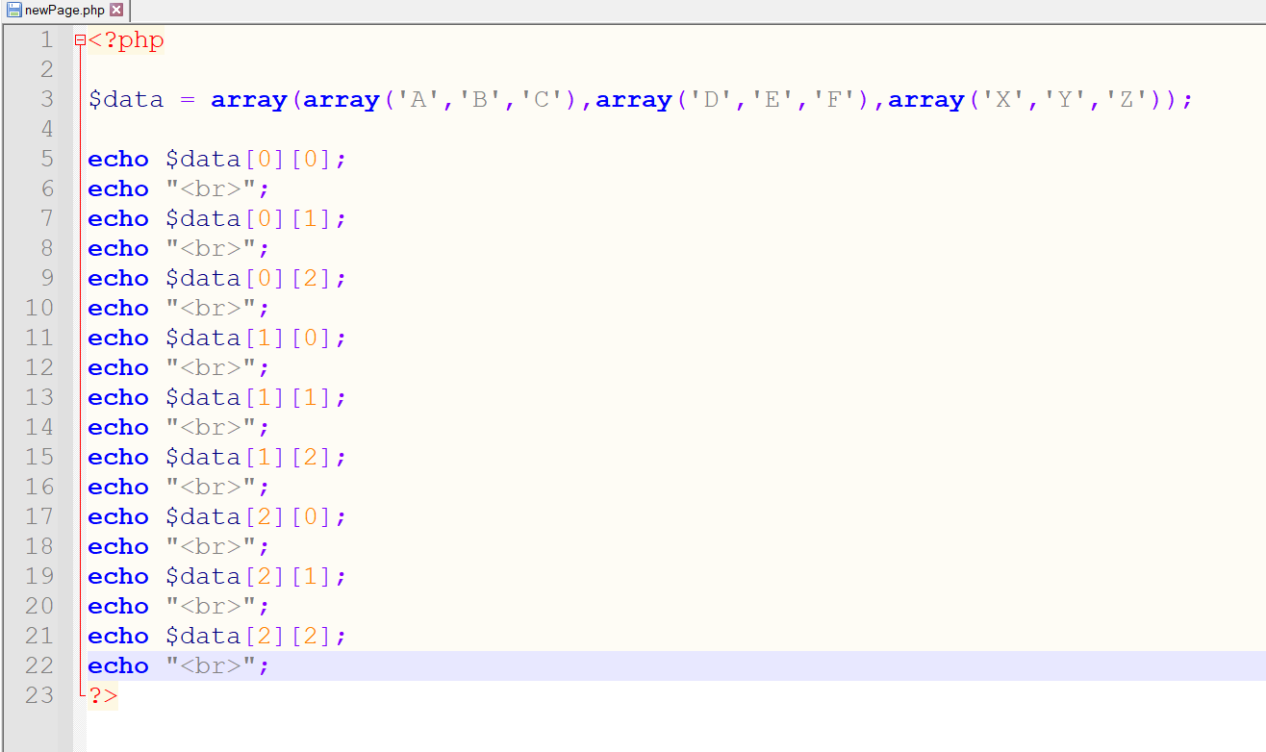
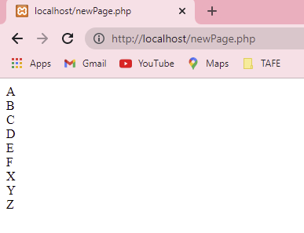
Defining a two-dimensional array
There are three array() constructs nested inside the outer array() construct.

Slide 14
Variable-naming rules
When creating PHP variables, you must follow these four rules:
Variable names must start with a letter of the alphabet or the _ (underscore) character.
Variable names can contain only the characters a-z, A-Z, 0-9, and _ (underscore). Variable names may not contain spaces.
If a variable must comprise more than one word, it should be separated with the _ (underscore) character (e.g., $ user_name).
Variable names are case-sensitive. The variable $ High_Score is not the same as the variable $ high_score.

